Slide 1


WINE QUALITY
ANALYSIS
By- Utkarsh Kulshrestha
Rishika Sharma

Slide 2
AGENDA
OBJECTIVE
DATA DESCRIPTION
DATA ANALYSIS
INSIGHTS FROM ANALYSIS

Slide 3
OBJECTIVE
The dataset contains information wines.
The dataset has 1000 data points of each wine with 13 characteristics(attributes).
Wine quality is measured on 0(low)-10(high) scale.
Management want
  To understand the characteristics of these wines.
  How different ingredients affect the quality.

Slide 4
DATA DESCRIPTION
The attributes are as follows
  fixed.acidity
  volatile.acidity
  citric.acid
  residual.sugar
  chlorides
  free.sulfur.dioxide
  total.sulfur.dioxide
  density
  pH
  sulphates
  alcohol
  quality

Slide 5
DATA ANALYSIS
To understand the characteristics of the wine and find ingredients contributing more for quality, we have done the following
  Design the heatmap and plotting histogram of each attribute.
  Subset the data based on good quality(True) and bad quality(False) and find descriptive statistics.
  Finding accuracy, precision and recall score of whole dataset.

Slide 6
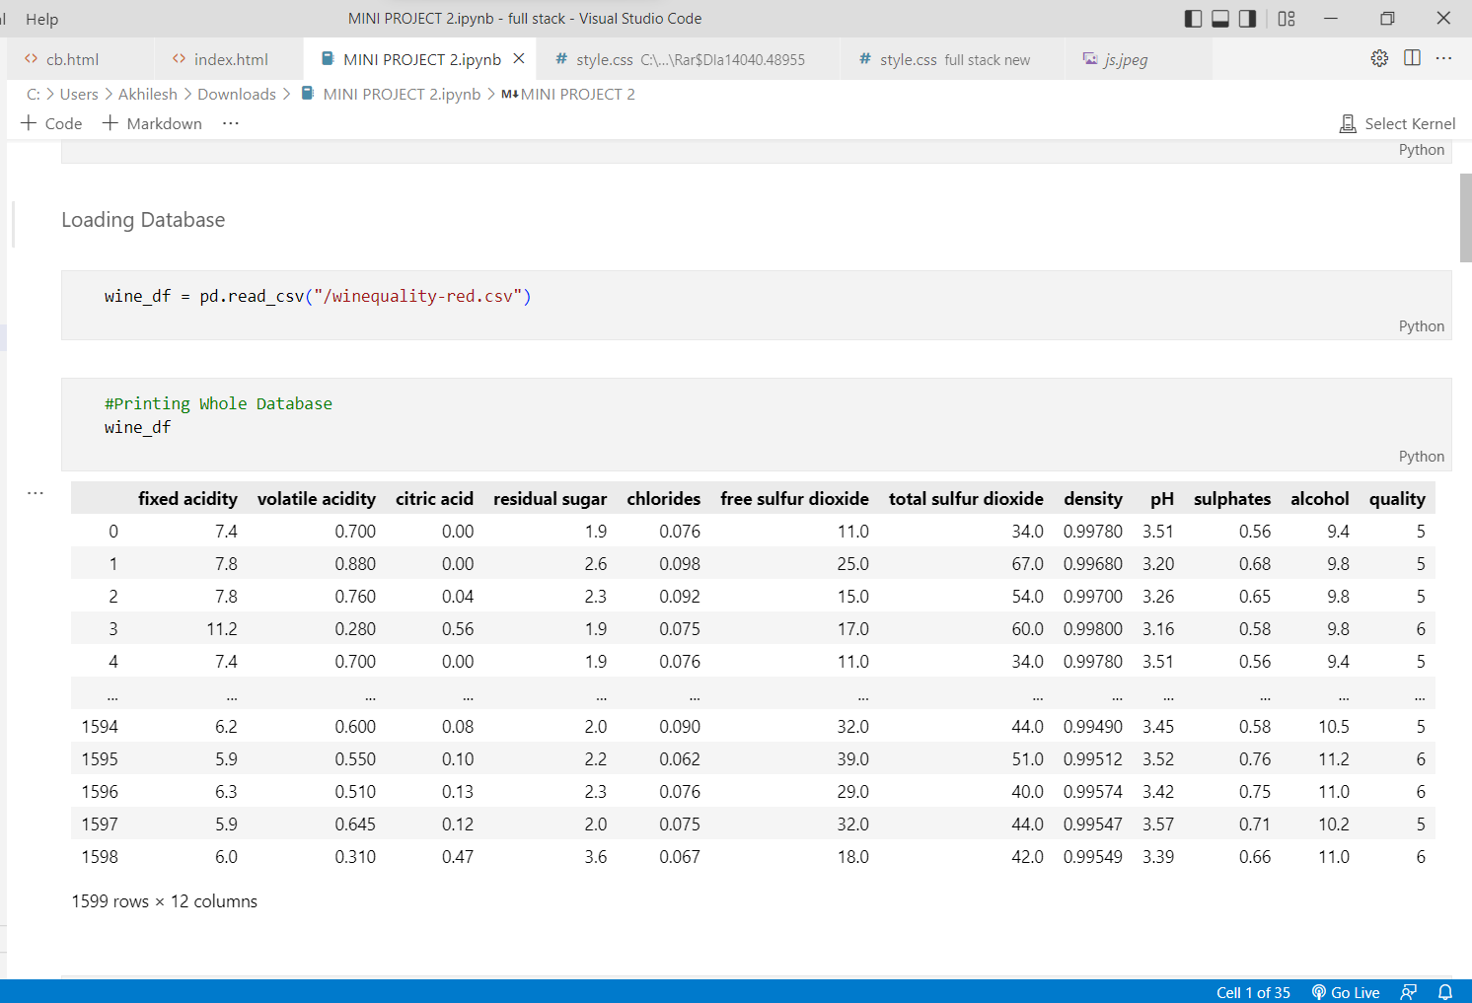
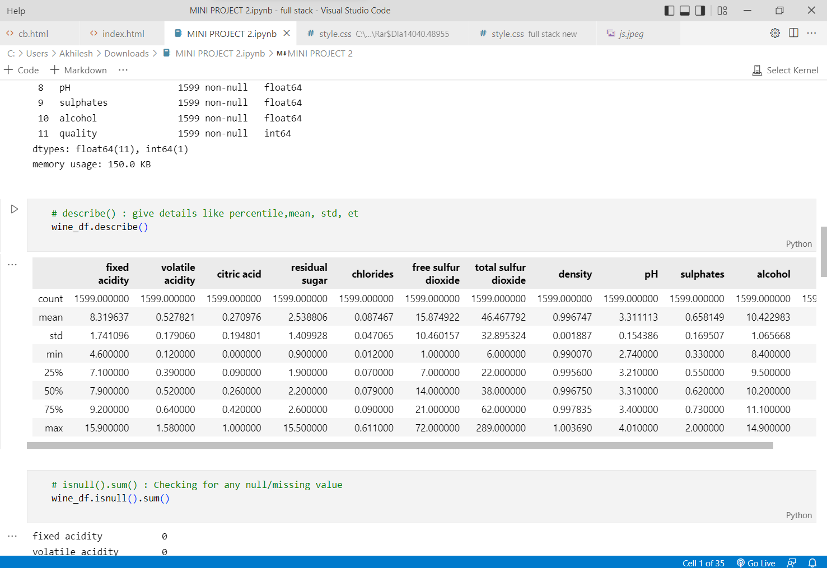
DATA ANALYSIS
IMPORTING THE DATASET
CALCULATING MEAN, COUNT, etc. OF ALL ATTRIBUTES

Slide 7
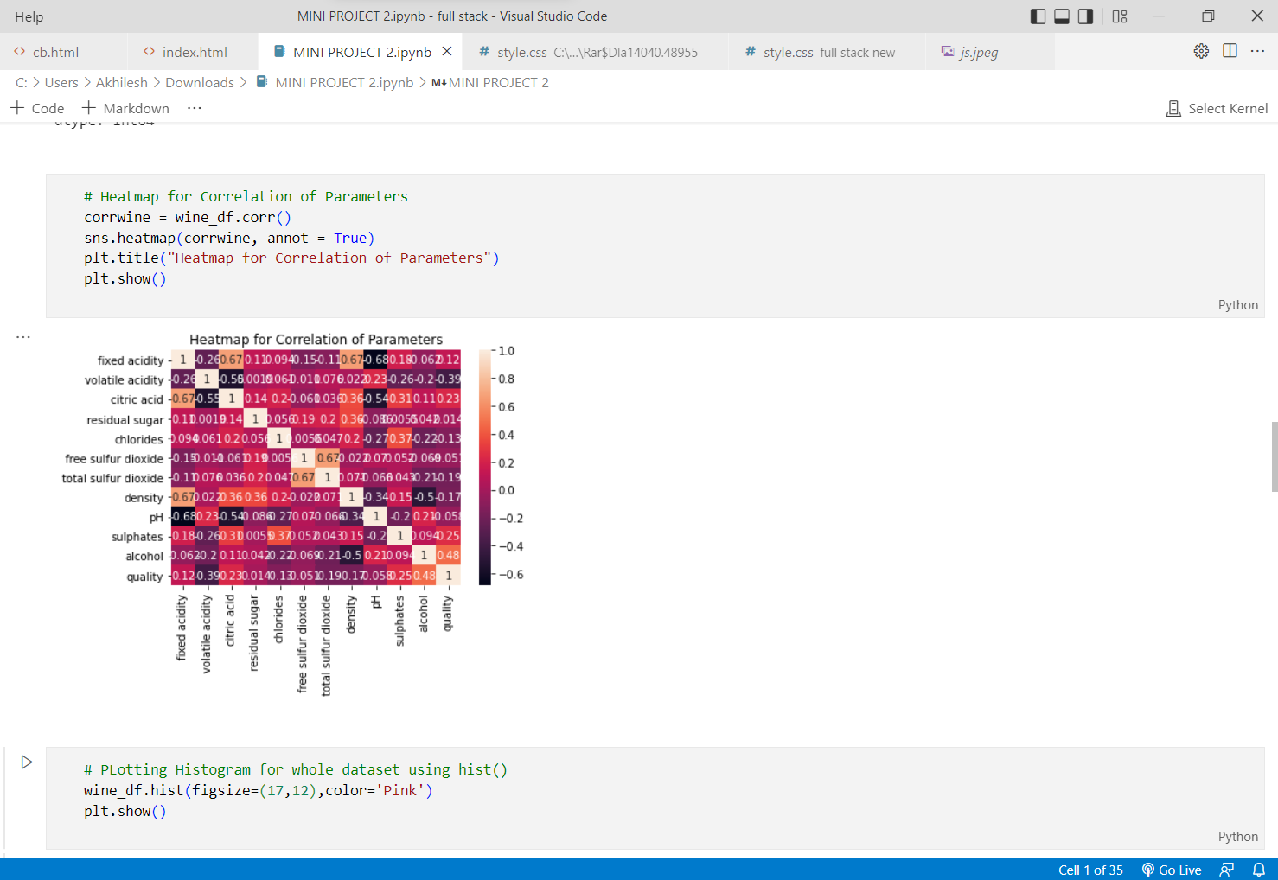
DATA ANALYSIS
Designing HeatMap for Correlation and Parameters.
A heatmap is a graphical representation of data where values are depicted by color.
They are essential in detecting what does or doesn't work on a website or product page.

Slide 8
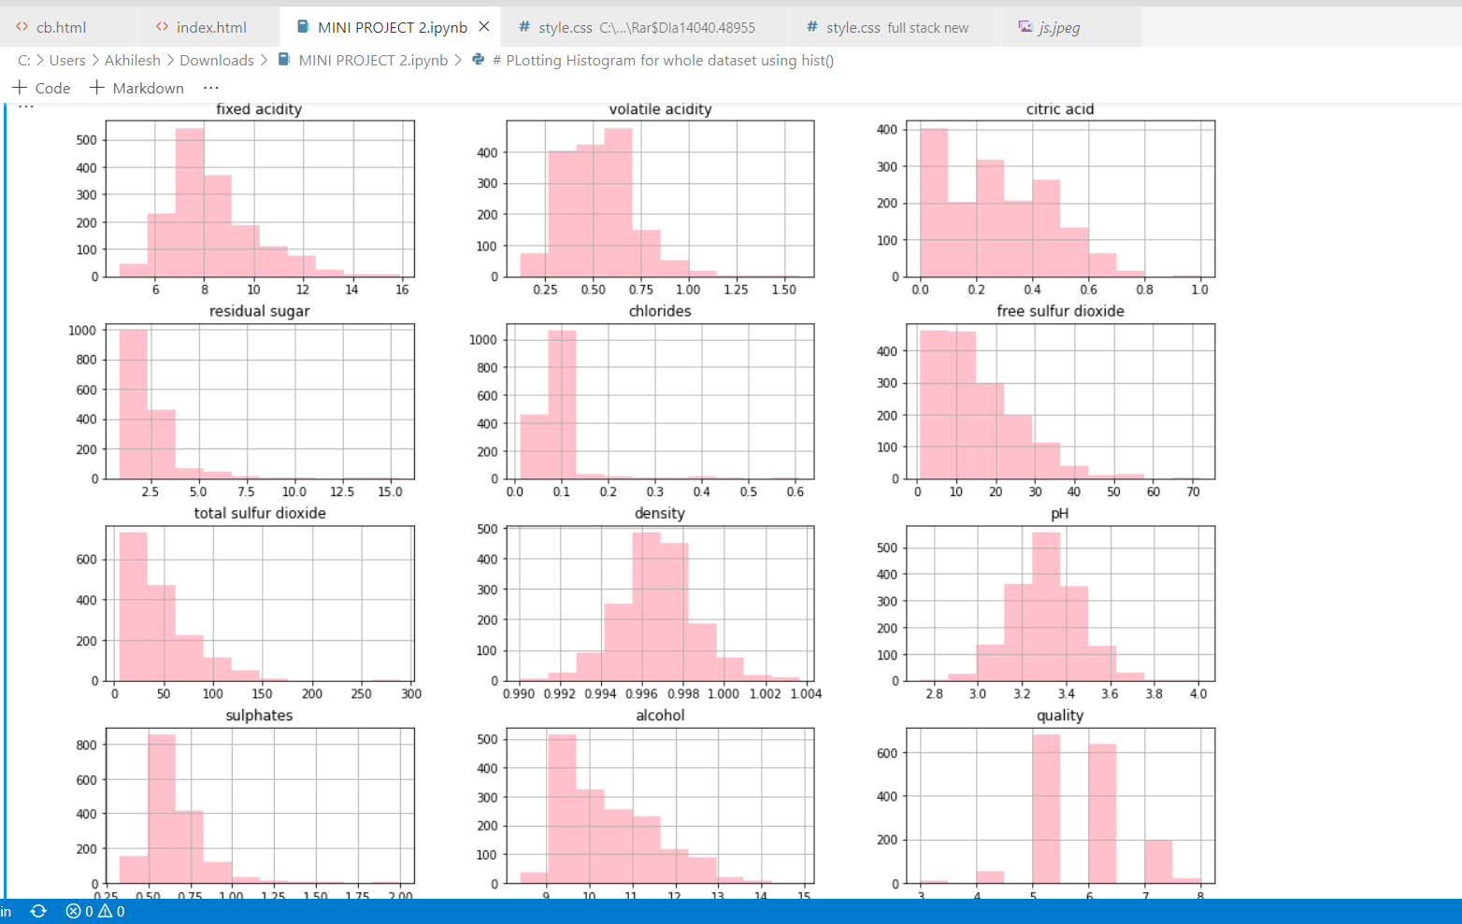
DATA ANALYSIS
Plotting Histogram of each attribute of Dataset

Slide 9
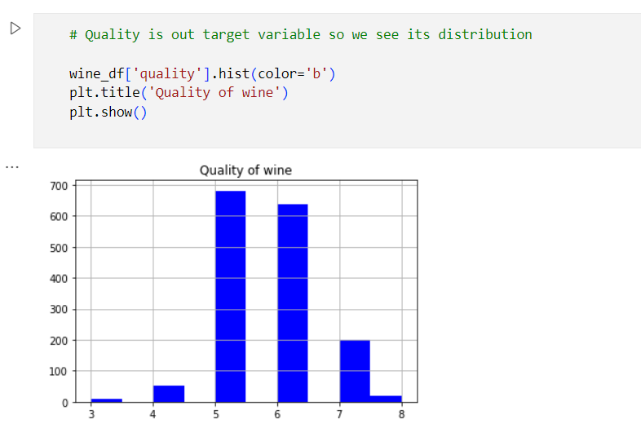
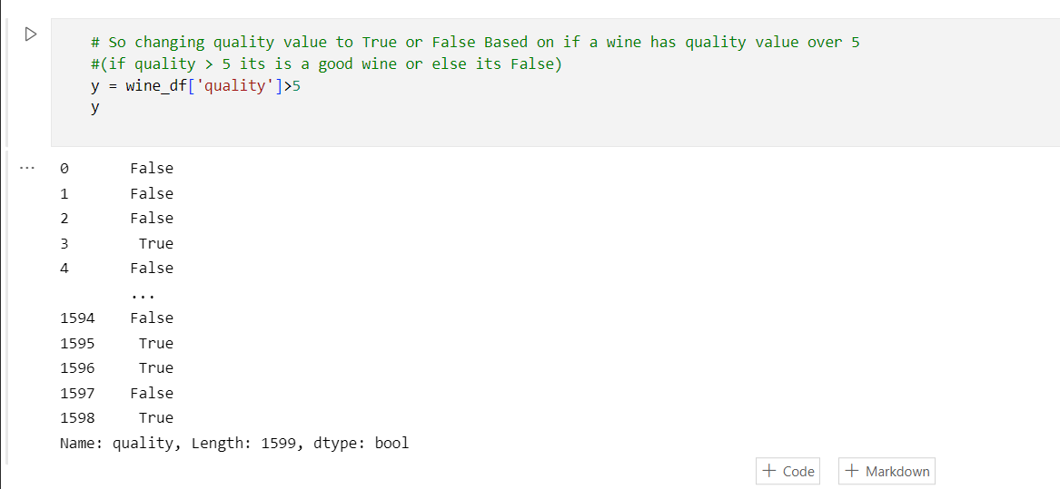
DATA ANALYSIS
Checking the quality of wine and changing the quality value of each wine to true or false.

Slide 10
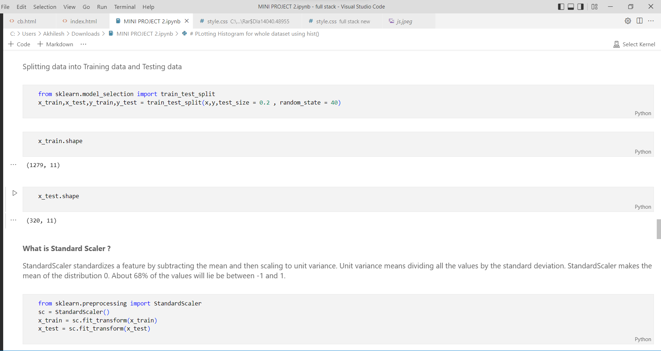
DATA ANALYSIS
Splitting Data into Training Data and Testing Data.
Training data is used to train the model.
Usually Training data is larger then Testing data. Once the Model is trained then the unseen data which is Testing Data is used to test the Model.
Then we use Standard Scaler which removes the mean and scales all values into unit variance which makes the calculation easy.

Slide 11
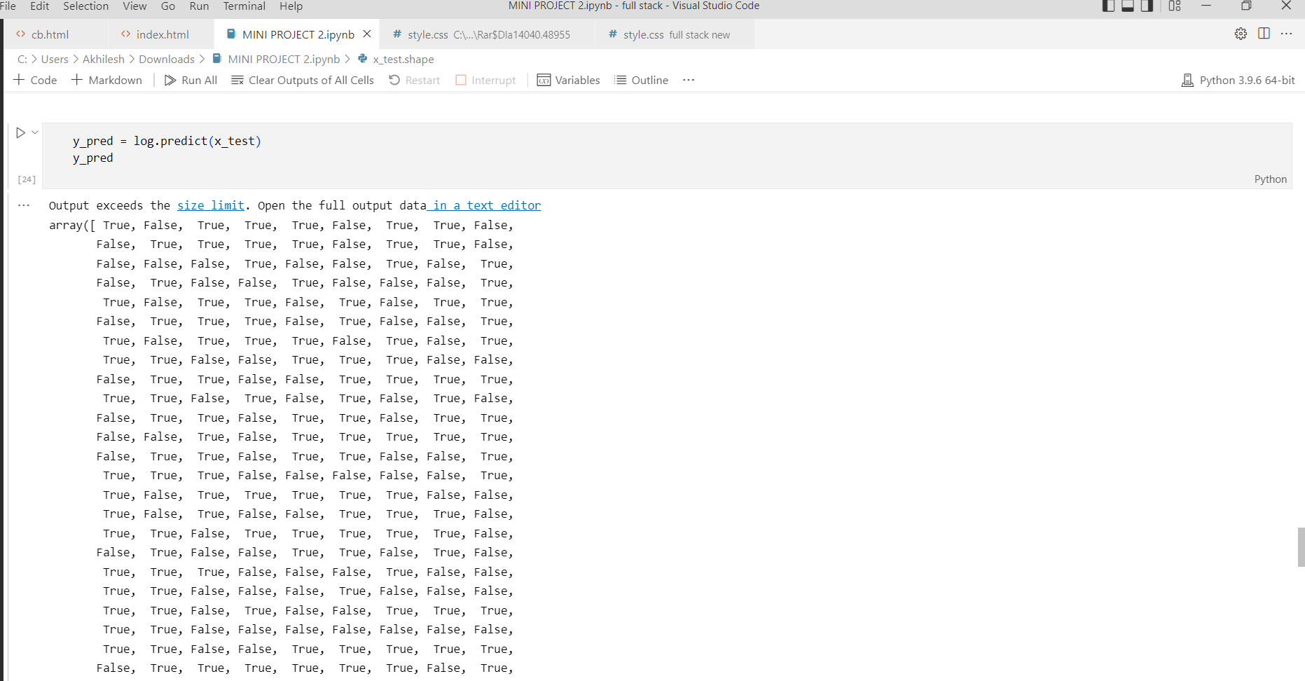
DATA ANALYSIS
Comparing the Data and Categorizing it into true or false

Slide 12
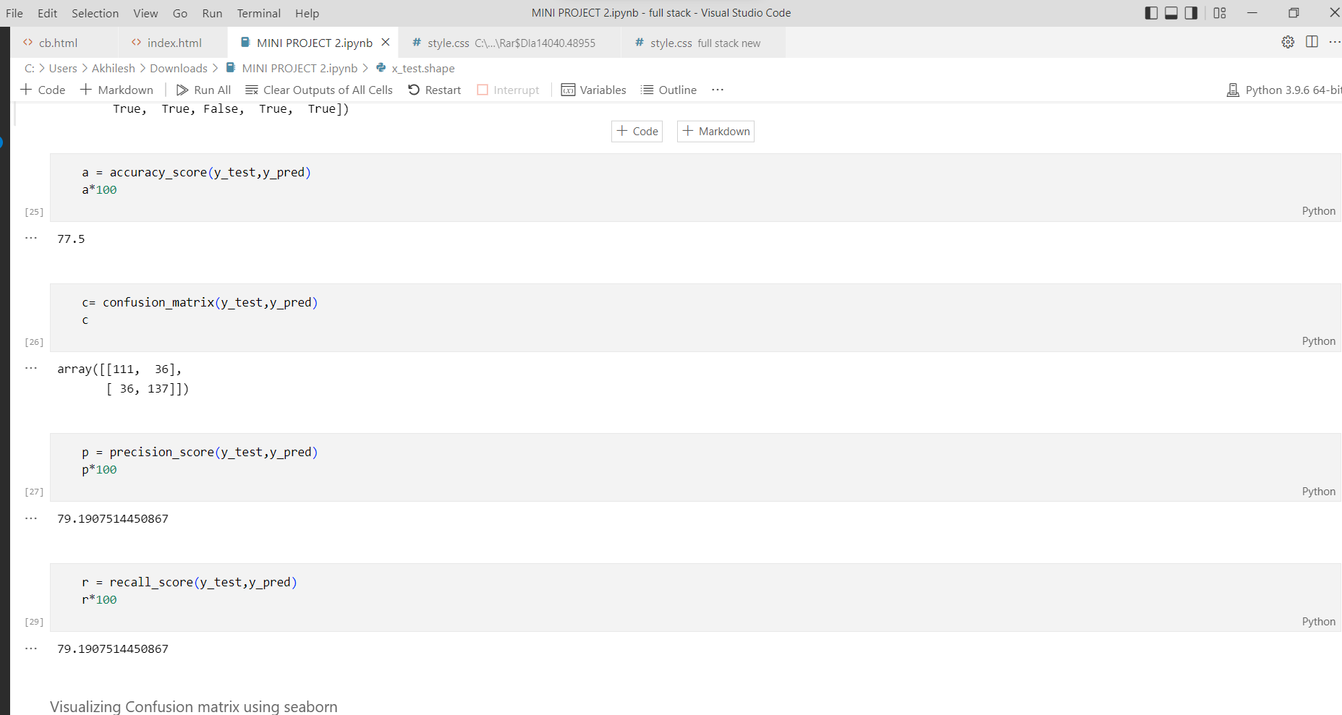
DATA ANALYSIS
Finding the Accuracy score, Precision Score, Recall Score of the dataset.
Accuracy tells you how many times the ML model was correct overall.
Precision is the ratio of number of correct predictions to the total number of predictions.
Recall is the ratio of correct positive predictions to the total positives examples.

Slide 13
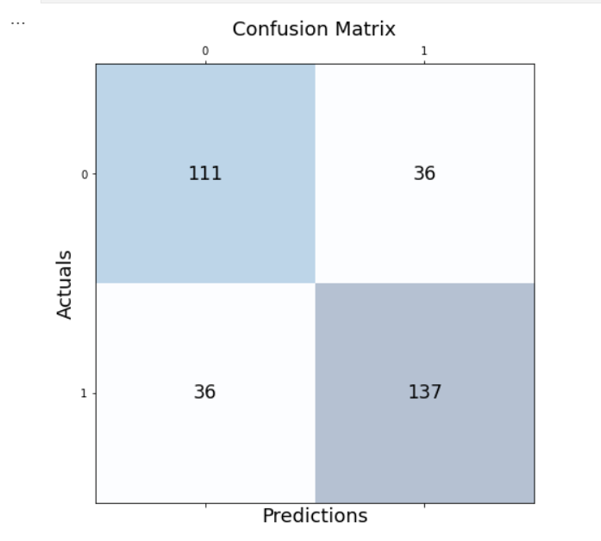
DATA ANALYSIS
CONFUSION MATRIX

Slide 14
INSIGHTS FROM ANALYSIS
Characteristics
  High or low quality
Ingredients which contribute more for quality of the wine.
  Alcohol.

Slide 15


